Slide 1
Analysing Job Portal Using Twitter Data
Leveraging Power BI for Job Insights
Presented by: Abinaya I
Date: March to June 2025

Slide 2
Introduction
Twitter is a dynamic platform with millions of daily active users.
Job-related tweets are an emerging data source for labor market insights.
This project focuses on extracting, visualizing, and analyzing job-related data from Twitter.

Slide 3
Tools and Technologies Used
- Data Sources: Twitter (via ChatGPT prompts), Excel
- Data Visualization Tool: Microsoft Power BI
- Tech Stack: Python (optional), Power Query, Bing Maps

Slide 4
Dashboard Overview
This dashboard presents insights derived from job-related Twitter data.
Visualizations include:
Job Titles and Types
Tweet Trends Over Time
Hashtag Popularity
Company-wise Job Listings
Location and Salary Distributions

Slide 5
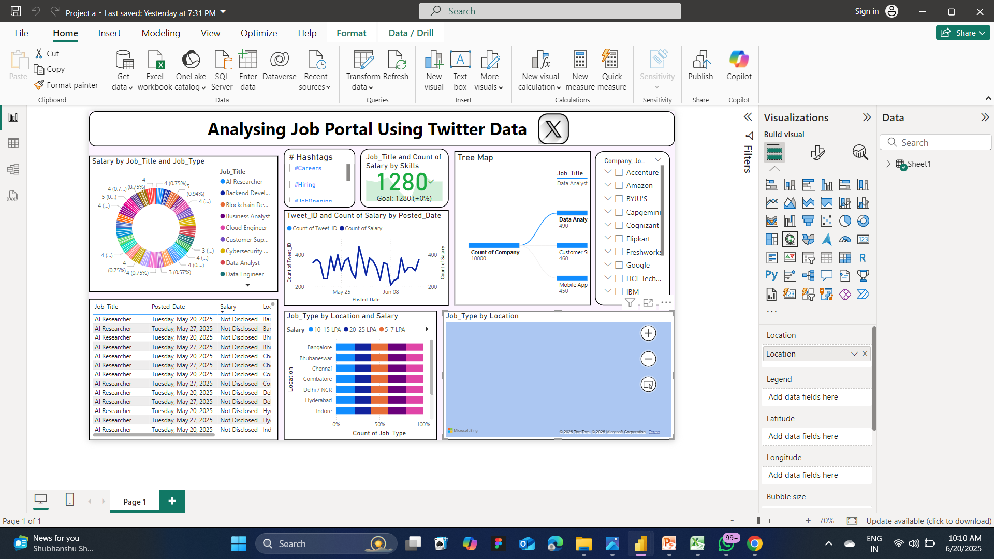
Output

Slide 6
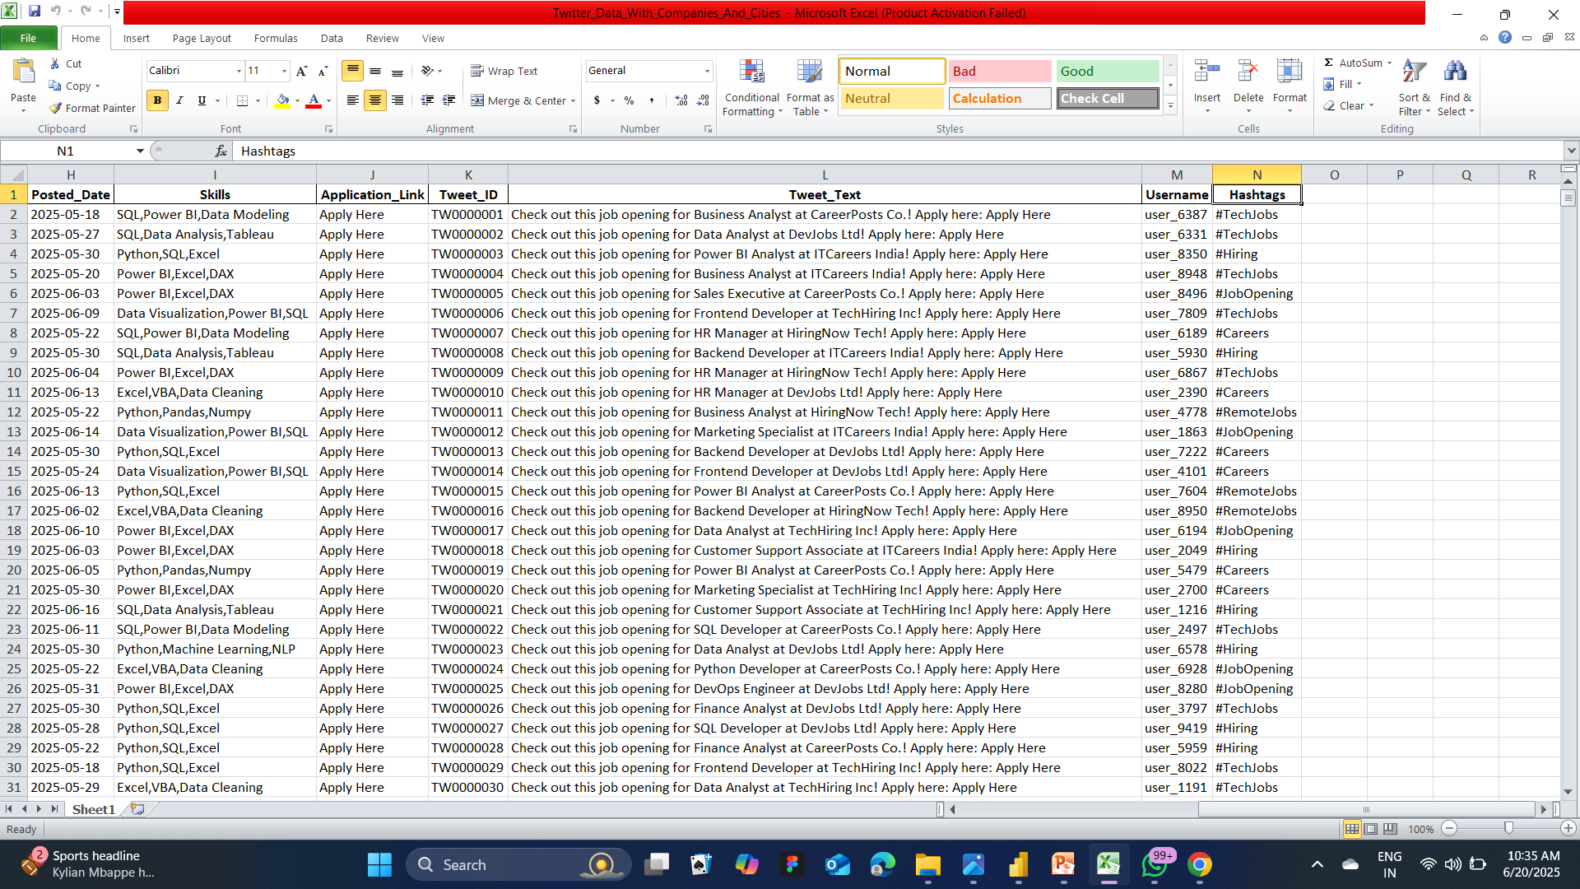
Excel Dataset Used

Slide 7
Key Insights
Popular Job Titles: Data Analyst, AI Researcher, Cloud Engineer
Top Hiring Companies: Accenture, Amazon, Google, IBM
Job Type Distribution: Diverse roles across cities like Bangalore, Hyderabad, and Chennai
Salary Ranges: Grouped into 5-7 LPA, 10-15 LPA, and 20-25 LPA

Slide 8
Data Flow Diagram
Step 1: Extract dataset using ChatGPT and Twitter hashtags
Step 2: Clean and organize data in Excel
Step 3: Import into Power BI
Step 4: Create dashboards and visualizations

Slide 9
Conclusion
Twitter offers rich, real-time job data.
Power BI enables intuitive analysis and storytelling.
This dashboard can help students, job seekers, and HR professionals.

Slide 10
Thank You

